Slide 1

X – Edu
PREDICTING
‘HOT LEADS’
FOR X-EDU COMPANY

Slide 2

X-Edu
X Edu Company is an online education company that sells online courses to Industry Professionals.
The Company is helping Industry Professionals reach their goals and pursue their dreams..

Slide 3
Industry Review :
Domain of Project : Education Sector
Project title : Predicting the Hot leads for ‘X-EDU company’ for attaining Higher Lead Conversion.
Business Overview : X Edu Company is an education company that sells online courses to industry professionals. Many professionals join their courses to up skill and also learn new areas of interest.
This company markets its courses on several websites and search engines like Google. Once these people land on the website, they might browse the courses or fill up a form for the course or watch some videos. When these people fill up a form providing their email address or phone number, they are classified to be a lead. Moreover, the company also gets leads through past referrals. Once these leads are acquired, employees from the sales team start making calls, writing emails, etc. Through this process, some of the leads get converted while most do not.

Slide 4
Benefits of online courses:
Flexibility: Most people who choose online learning tend to have other commitments, and prefer this mode of learning as it gives them power over how they will delegate their time towards their different projects.
Reduced Costs: Online education can cost less due to a variety of reasons like students need not pay for infrastructure, travel etc.
Networking Opportunities: Online education also provides students with the chance to network with peers across nations or even different continents. This often leads to other opportunities in terms of collaboration with other individuals in the implementation of a project. At the same time, it makes them culturally sensitive and able to fit into other environments easily given their exposure to other cultures.
Documentation: All the information that you will need will be safely stored in an online database.
Access to Expertise: An online college education might give students access to specialized degree courses that may not be available in an easily accessible or local institution of learning.

Slide 5








Popular online courses in India :

Slide 6

Current Practices:
Through Machine Learning Models we can maximise Lead Conversion Rates for the company.
Predictive Analysis can help us to distinguish the ‘Hot Leads’ and ‘Cold Leads’ and help organisations by providing the required actionable insights.

Slide 7
Background Research: Nowadays, successful modern companies are heavily investing in understanding their customers, products, and services by leveraging data-driven models and insights.
Some of the current researches are being conducted to answers these questions:
What is the predictive lead scoring?
How is this predictive lead scoring important to the success of a company’s acquisition and sales strategies?
How can you develop a lead scoring model to optimize the volume of customers and prospects with anticipated qualities at each stage along the customer journey?
How can the marketing and sales teams effectively monitor the predicted lead scores as well as track the lead quality and performance over time?

Slide 8






Applications :
Lead scoring software is used by companies to determine the potential of each business opportunity. By using this type of software, companies can create scales and benchmarks to rank prospects against. A sales team’s time can be valuable and leads can be numerous, so lead scoring software can help teams focus on those lead opportunities that are most likely to convert into sales.
Best Lead Scoring Software in the market :
ActiveCampaign
6sense
VanillaSoft
Velocify Lead Manager
Infer
Leadspace
Slintel

Slide 9

Undergoing Research:
Continuous Research is being conducted to Aim for continuous growth and improvement :
Most importantly, a lead scoring model that’s developed for growth is the real game-killer.
Be open for maintenance, testing, tweaking, and improvement. Developing lead scoring system takes time, but it can always be improved.
Check monthly or biweekly to make sure everything is working fine and updated. In addition to CRM tool that automates solution, also identify scores, especially for behavioural lead scoring, that needs to be reset over time. Also, company needs to work hand in hand with sales department as they are more experienced in handling the leads, hence, they should be involved in the process.

Slide 10
Dataset and Domain
Original owner of data | Amrita Chatterjee
Data set information | https://www.kaggle.com/amritachatterjee09/lead-scoring-dataset
Any past relevant articles using the dataset | None
Reference | Kaggle
Link to web page | https://www.kaggle.com/amritachatterjee09/lead-scoring-dataset
References
The References are blogs, articles or social media news explaining the importance of the projects:
https://vwo.com/blog/lead-conversion-strategies/ -
https://towardsdatascience.com/maximizing-lead-conversion-and-marketing-effectiveness-through-advanced-analytics-an-automobile-cf190f154a4d
https://www.freshworks.com/crm/solutions/lead-scoring/lead-scoring-model-so-sales-work-on-the-hottest-leads-blog/
https://www.leadsquared.com/lead-conversion-platform/
Predictive Lead Scoring. Nowadays, successful modern companies… | by Weiwei Hu | Towards Data Science
https://blog.marketo.com/2014/06/how-predictive-lead-scoring-takes-the-guesswork-out-of-identifying-the-leads-most-likely-to-buy.html
https://blog.marketo.com/2011/07/lead-scoring-whats-hot-and-whats-not-2.html

Slide 11
Data Dictionary
Prospect ID - A unique ID with which the customer is identified.
Lead Number - A lead number assigned to each lead procured.
Lead Origin - The origin identifier with which the customer was identified to be a lead. Includes API, Landing Page Submission, etc.
Lead Source - The source of the lead. Includes Google, Organic Search, Olark Chat, etc.
Do Not Email -An indicator variable selected by the customer wherein they select whether of not they want to be emailed about the course or not.
Do Not Call - An indicator variable selected by the customer wherein they select whether of not they want to be called about the course or not.
Converted - The target variable. Indicates whether a lead has been successfully converted or not.
Total Visits - The total number of visits made by the customer on the website.
Total Time Spent on Website - The total time spent by the customer on the website.
Page Views Per Visit - Average number of pages on the website viewed during the visits.
Last Activity - Last activity performed by the customer. Includes Email Opened, Olark Chat Conversation, etc.
Country - The country of the customer.
Specialization - The industry domain in which the customer worked before. Includes the level 'Select Specialization' which means the customer had not selected this option while filling the form.
How did you hear about X Education - The source from which the customer heard about X Education.
What is your current occupation - Indicates whether the customer is a student, unemployed or employed.
What matters most to you in choosing this course An option selected by the customer - indicating what is their main motto behind doing this course.
Search - Indicating whether the customer had seen the ad in any of the listed items.
Through Recommendations - Indicates whether the customer came in through recommendations.
Receive More Updates About Our Courses - Indicates whether the customer chose to receive more updates about the courses.
Tags - Tags assigned to customers indicating the current status of the lead.
Lead Quality - Indicates the quality of lead based on the data and intuition the employee who has been assigned to the lead.
Update me on Supply Chain Content - Indicates whether the customer wants updates on the Supply Chain Content.
Get updates on DM Content - Indicates whether the customer wants updates on the DM Content.
Lead Profile - A lead level assigned to each customer based on their profile.
City - The city of the customer.
Asymmetric Activity Index - An index and score assigned to each customer based on their activity and their profile
Asymmetric Profile Index
Asymmetric Activity Score
Asymmetric Profile Score
I agree to pay the amount through cheque - Indicates whether the customer has agreed to pay the amount through cheque or not.
A free copy of Mastering The Interview - Indicates whether the customer wants a free copy of 'Mastering the Interview' or not.
Last Notable Activity - The last notable activity performed by the student.

Slide 12
Dataset :
Dataset
Row or record count | 9240
Column count | 37
Variable categorization :
Numerical Columns | Categorical Columns
7 | 30
Dropping Highly Imbalanced Categorical Features
Search
Newspaper Article
Newspaper
Receive More Updates About Our Courses
Through Recommendations

Slide 13
Pre-Processing Data Analysis :
Features with Null values:
Features with null value | %
Lead Source 0.389610
TotalVisits 1.482684
Page Views Per Visit 1.482684
Last Activity 1.114719
Country 26.634199
Specialization 15.562771
How did you hear about X Education 23.885281
What is your current occupation 29.112554
What matters most to you in choosing a course 29.318182
Tags 36.287879
Lead Quality 51.590909
Lead Profile 29.318182
City 15.367965
Asymmetrique Activity Index 45.649351
Asymmetrique Profile Index 45.649351
Asymmetrique Activity Score 45.649351
Asymmetrique Profile Score 45.649351

Slide 14
Binning and Imputation:
We have performed appropriate imputations and binning for required columns.
Binning
For example we have binned categories like select and NAN under one category as ‘Unknown’. ( Specialization,Tags columns)
For example if percentage of null values is high in categorical columns then we replaced it with some other category instead of mode value in order to avoid over representation of mode value. (Tags, Country columns)
Imputations
Median Imputation was done for continuous features.
TotalVisits
Page Views Per Visit
Asymmetrique Profile Score
Asymmetrique Activity Score

Slide 15
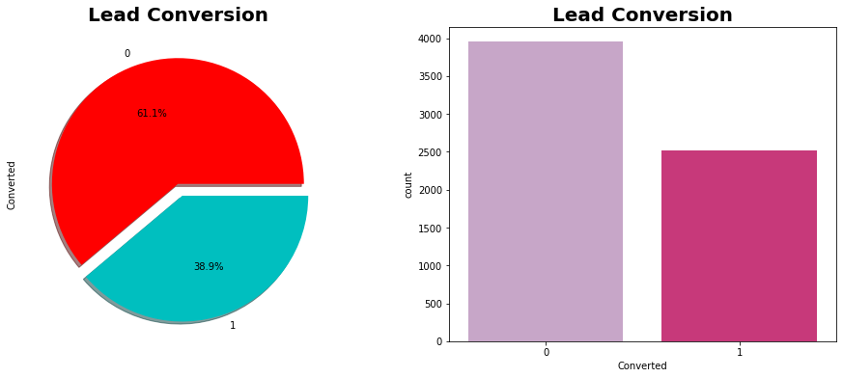
Data Exploration (EDA)
Checking class imbalance
The ratio of Converted and Non-Converted is between 60:40 approx. So there is not much class imbalance.

Slide 16
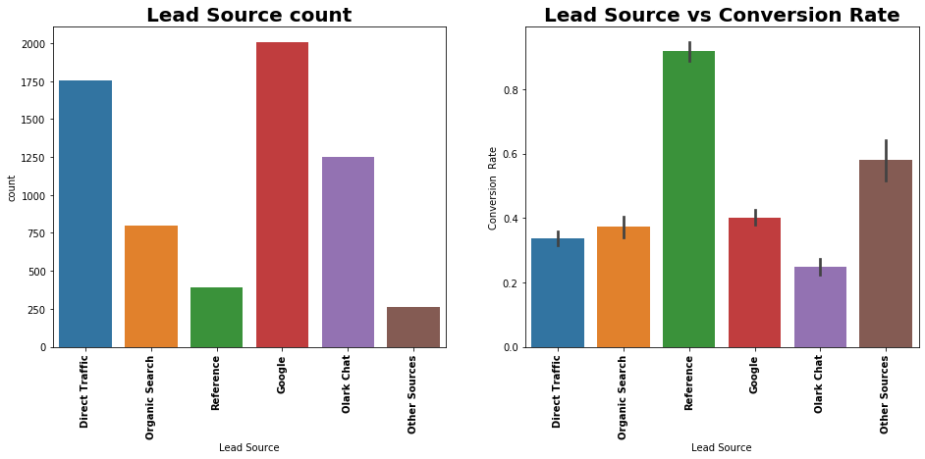
Univariate and Bivariate Analysis (Lead Source)
The highest leads are coming from ‘Google Search’ followed by ‘Direct Traffic’ and ‘Olark Chat’, however the conversion rate for these sources are low because the ratio of no of converted people to the no of non-converted people for these sources are lower than rest of the other sources. Further in our presentation we will see that same assessment follows for few other categorical features as well.
The Conversion rate for ‘Reference’ is the highest among other lead sources.

Slide 17
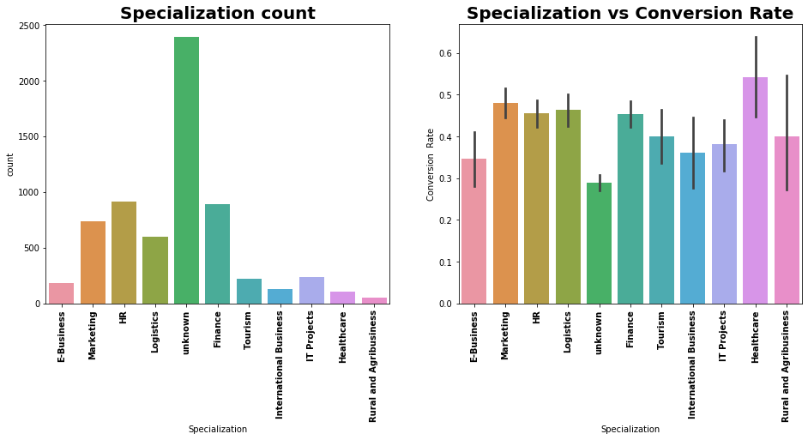
Univariate And Bivariate Analysis (Specializations)
Highest count of leads are coming from ‘HR’ and ‘Finance’ Specializations.
(*Ignoring Unknown Specializations as Specializations is not mentioned in the dataset)
‘Healthcare Specialization’ is contributing the most to the lead conversion rate followed by Marketing and Logistics.

Slide 18
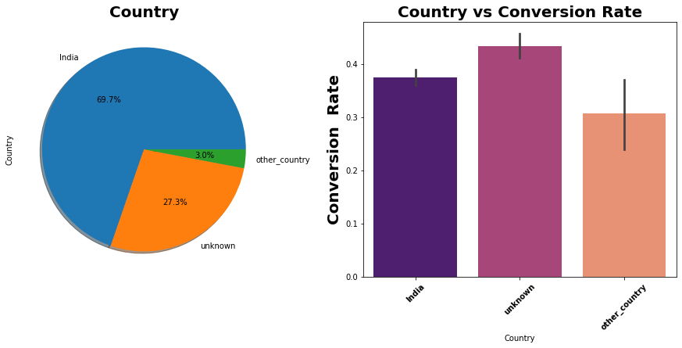
Univariate Analysis And Bivariate Analysis (Country)
Highest number of leads are coming from India i.e. approximately 70% leads are only coming from India.
But Unknown countries is giving us higher conversion rate as compared to India.

Slide 19
United States 0.819419
United Arab Emirates 0.510204
Singapore 0.247372
Saudi Arabia 0.216450
United Kingdom 0.154607
Qatar 0.092764
Bahrain 0.092764
Hong Kong 0.077304
Australia 0.077304
unknown 0.061843
France 0.061843
Germany 0.061843
Oman 0.061843
Nigeria 0.046382
Canada 0.046382
Philippines 0.030921
Bangladesh 0.030921
Italy 0.030921
South Africa 0.030921
Kuwait 0.030921
Asia/Pacific Region 0.030921
China 0.015461
Netherlands 0.015461
Malaysia 0.015461
Uganda 0.015461
Sri Lanka 0.015461
Denmark 0.015461
Vietnam 0.015461
Sweden 0.015461
Ghana 0.015461
Tanzania 0.015461
Switzerland 0.015461
Kenya 0.015461
Russia 0.015461
Indonesia 0.015461
These are the countries which were grouped into ‘Others’ as their frequency counts were very low and carried very less percentage of information.

Slide 20
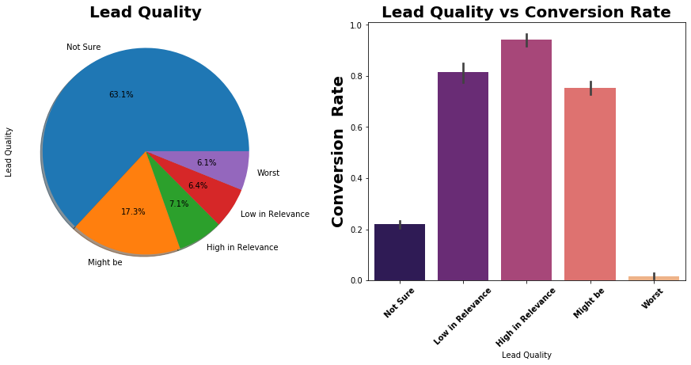
Univariate And Bivariate Analysis (Lead Quality)
For most of the lead counts we are not sure about the Lead Quality.
‘High in Relevance’ Leads has the highest conversion rate followed by ‘Low in Relevance’ Leads.
The ‘Might be’ leads conversion rate is also fairly good compared to ‘High’ and ‘Low’ in Relevance Lead Quality.

Slide 21
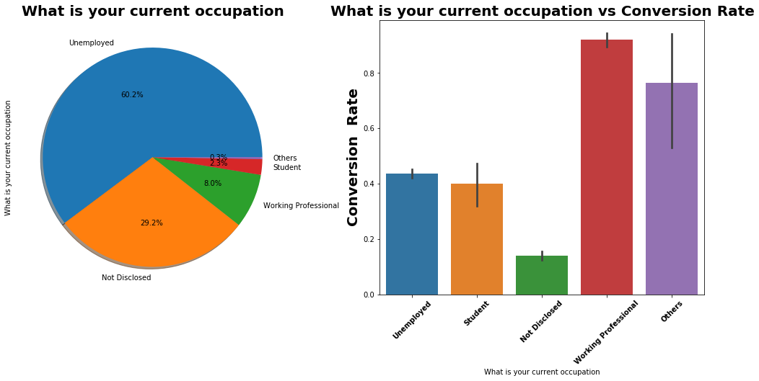
Univariate And Bivaraite Analysis (Current Occupation)
‘ Un-employed’ category is the highest however the conversion rates.
‘Working professionals’ has the highest lead conversion rate since the ratio of no of converted people to the no of non-converted people for Unknown countries is higher than that of India.

Slide 22
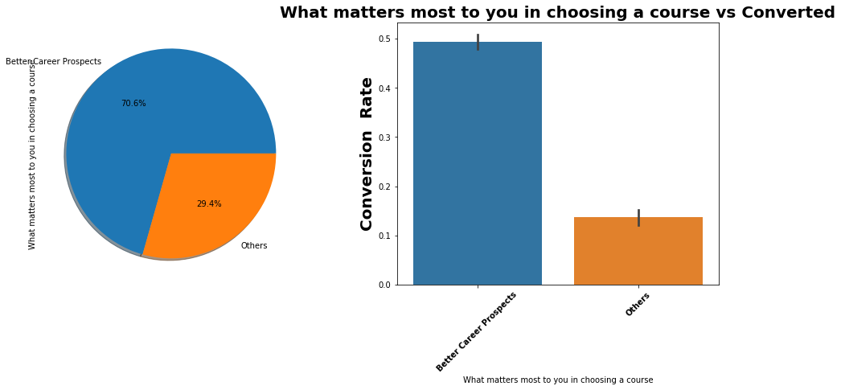
Univariate And Bivariate Analysis (What matters most to you in choosing a course)
Most of the leads are looking for better career prospects as it is giving us the highest conversion rate..

Slide 23
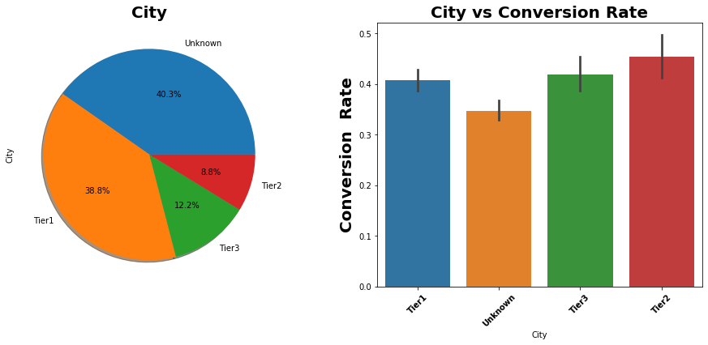
Univariate And Bivariate Analysis (City)
Majority of the leads are coming from Tier1 Cities followed by Tier3 and Tier 2.
(*40% is unknown city in the dataset)
However conversion rate for Tier2 Cities is highest followed by Tier3 and Tier1 because the ratio of no of converted people to the no of non-converted people for Tier 2 cities is higher as compared to Tier 3 and Tier1 cities.

Slide 24
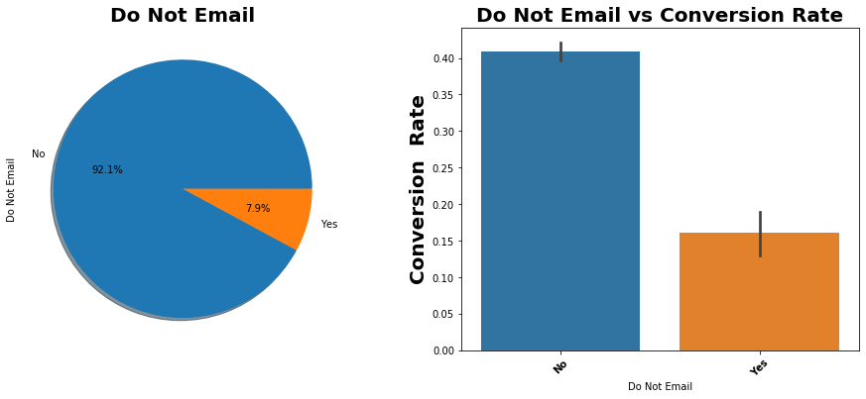
Univariate And Bivariate Analysis (Do Not Email)
92% of the leads have given positive response for ‘Email Communication’ and also the conversion rate for this category is on the higher side.

Slide 25
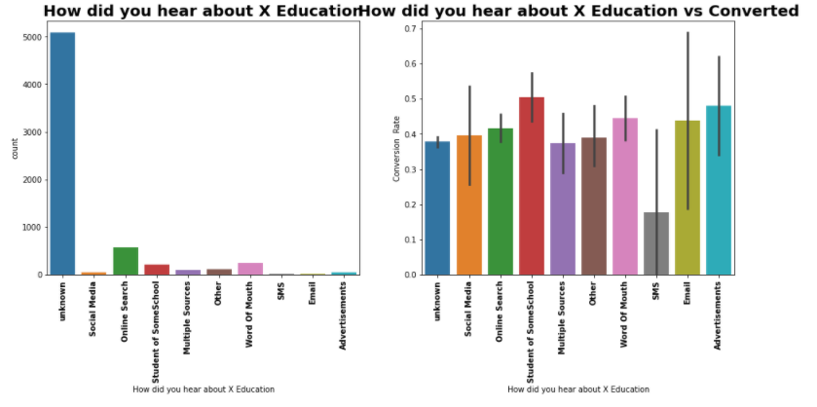
Univariate Analysis and Bivariate (How did you hear about X Edu)
Most of the leads have heard about the X Edu through ‘online search ‘ and ‘word of mouth’.
However ‘Student of Some School’ and ‘Advertisements’ are contributing most to the Lead Conversion Rate as the ratio of no of converted people to the no of non-converted people for ‘Student of Some School’ and ‘Advertisements’ is higher than other communication mediums.

Slide 26
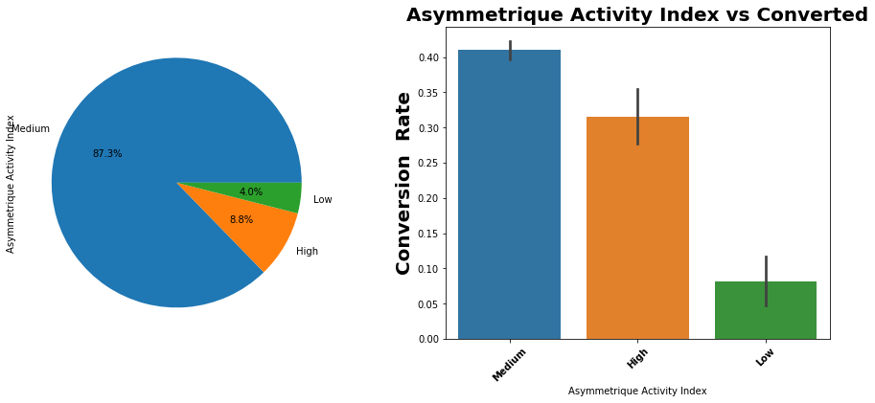
Univariate And Bivariate Analysis (Asymmetrique Activity Index)
Most of the leads belongs to medium Asymmetrique Activity index category.
The conversion rate for medium asymmetrique activity index category is highest among other index.

Slide 27
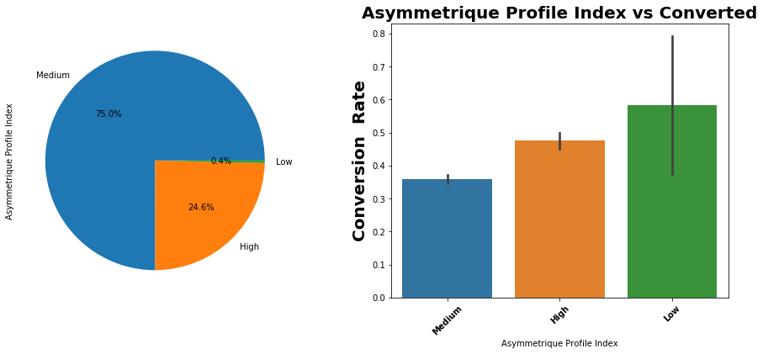
Univariate And Bivaraite Analysis (Asymmetrique Profile Index)
Most of the leads belongs to ‘Medium Asymmetrique Profile index’ .
The conversion rate for ‘Low Asymmetrique profile index’ category is the highest.

Slide 28
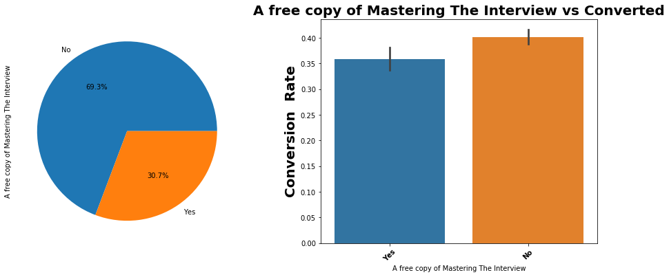
Univariate And Bivariate Analysis (A free copy of Mastering The Interview)
Only 30% of the leads have opted for free copy of ‘Mastering The Interview’ course.
The Conversion rate for this category is comparatively higher than leads who have not opted for the free course.

Slide 29
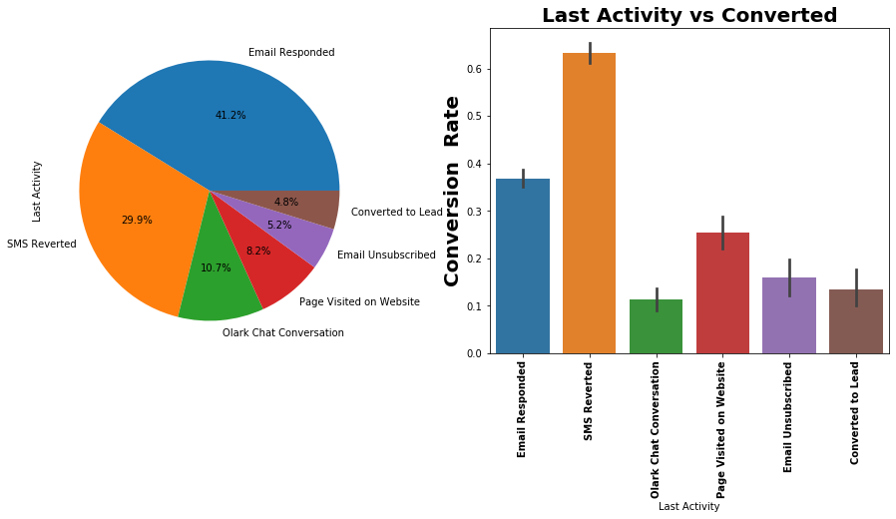
Univariate And Bivariate Analysis (Last Activity)
‘SMS Reverted’ and ‘Email Responded’ is the last activity for most of the leads.
Also the leads with last activity as ‘SMS Reverted’ is giving the highest lead conversion rate followed by ‘Email responded’.

Slide 30
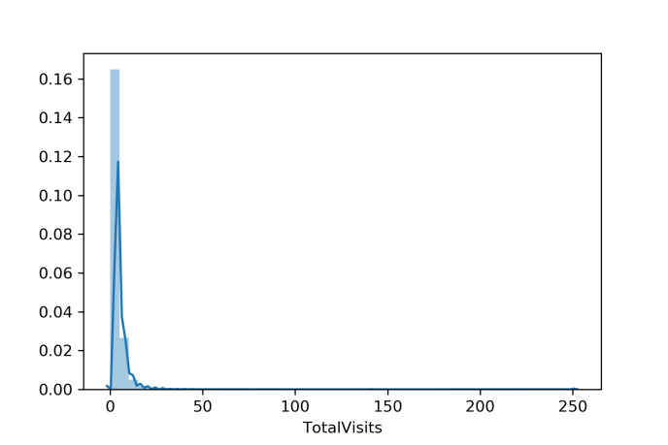
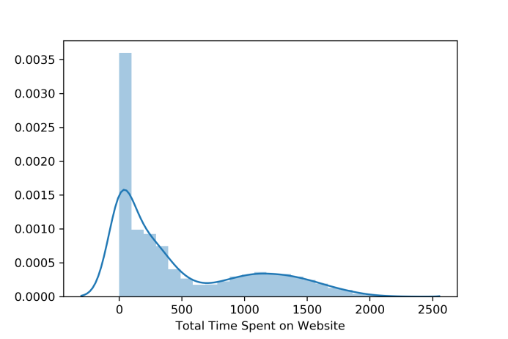
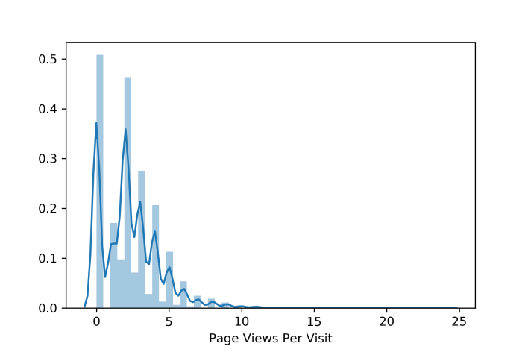
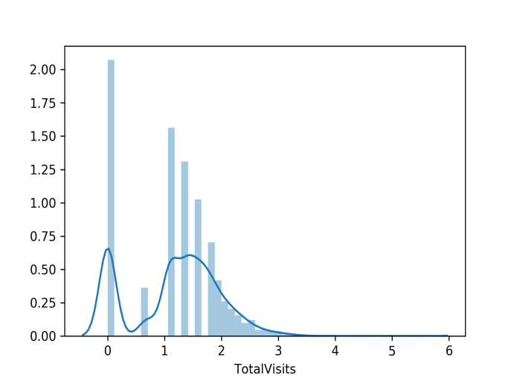
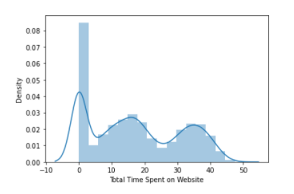
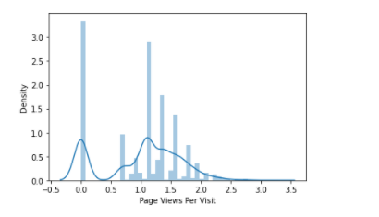
Univariate analysis(Before/ After transformation of Numerical features)
Before Transformation
Before Transformation
Before Transformation
Before transformation
After Transformation
After Transformation
After Transformation
skewness for column TotalVisits Before and After transformation = 22.743(before) | -0.135(after)
skewness for column Total Time Spent on Website = 0.96 (before) | 0.252(after)
skewness for column Page Views Per Visit = 1.49(before) | -0.296(after)

Slide 31
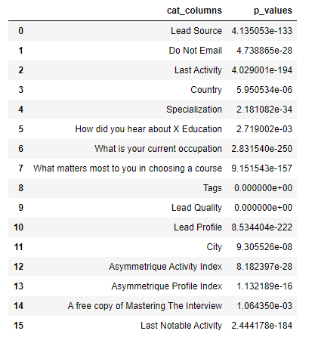
Checking relationship of categorical columns with the target on the basis of appropriate statistical tests (Bivariate analysis)
P-Values :
Since all p values are less than 0.05 => all our categorical variables are statistically significant.

Slide 32
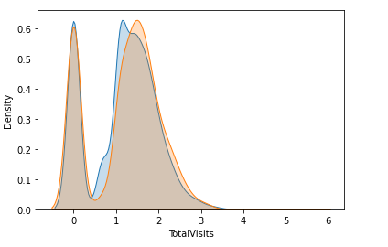
Checking relation between each numerical column and target (Bivariate analysis)
Checking Relationship between Total Vsists and Target column
MannwhitneyuResult(statistic=4759231.5, p-value=0.001743130890003308)
from the above plot also we can see that column Page Views Per Visit is not able to distinguish the classes in our target feature. So it is not relevant.

Slide 33
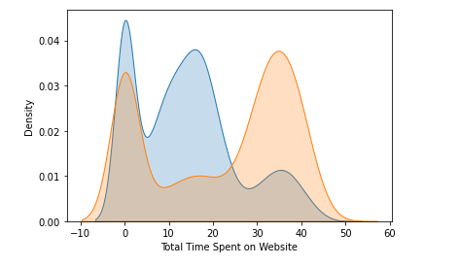
Checking Relationship between Time Spent on Website and Target column
MannwhitneyuResult(statistic=3494823.5, p-value=6.143277738507575e-92)
since p value < 0.05 => Total Time Spent on Website is statistically significant feature
from the above plot also we can see that column Total Time Spent on Website is able to distinguish the classes in our target feature. So it is a relevant feature.

Slide 34
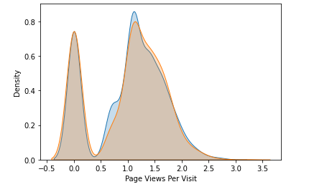
Checking Relationship between Page Views per Visit and Target column
MannwhitneyuResult(statistic=4950328.0, pvalue=0.39167679027035596)
From the above plot also we can see that column Page Views Per Visit is not able to distinguish the classes in our target feature. So it is a irrelevant feature.

Slide 35
Final Conclusions on Numerical Columns
1st for TotalVisits
Variance= 0.6321650428480624 => variance is low and it carries no information. So it is insignificant.
From the plot we were able to see that column TotalVisits is not able to distinguish the classes in our target feature. So it is not a relevant feature.
Statistically it is coming significant.
On the basis of points 1 and 2 => we can drop this feature.
2nd for Total Time Spent on Website
1) variance of column Total Time Spent on Website = 192.3914012409157 => variance is high and it carries information. So it is a significant feature.
2) from the plot for this column we were able to see that Total Time Spent on Website is able to distinguish clearly between the classes in our target feature. So it is a relevant feature.
3) statistically also it is coming significant.
On the basis of points 1,2 and 3 => we need to keep this feature
3rd for Page Views Per Visit
1) variance of column Page Views Per Visit = 0.43606870385195484 => variance is low and it carries no information. So it is insignificant.
2) from the plot we were able to see that column Page Views Per Visit is not able to distinguish between the classes in our target feature. So it is not a relevant feature.
3) statistically aslso it is insignificant.
On the basis of points 1,2 and 3 => we need to drop this feature

Slide 36
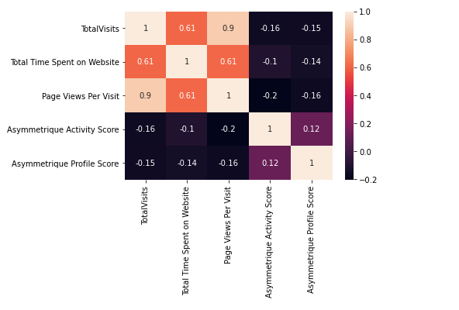
Checking Correlation between numerical columns (Multivariate analysis)
Total Visits and Total time spent on website is having High Positive correlation.
Page views per visit and Total time spent on website is having High Positive correlation.

Slide 37
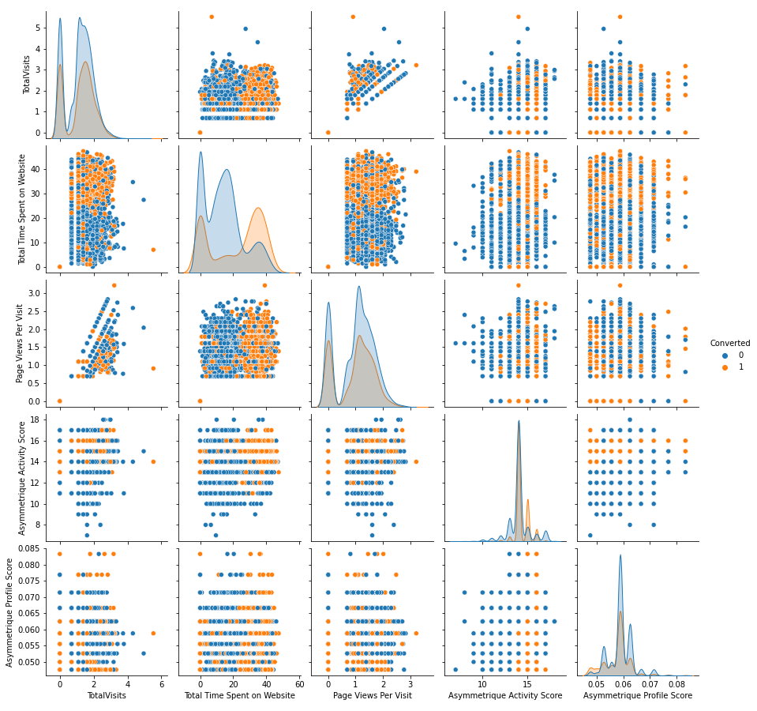
Pairplot (Trainset):

Slide 38
Model Results and Evaluation
Our model evaluation is done on the basis of F1 score, since for the business problem both Precision and Recall carries the equal importance.
In this business problem when Cold Leads are getting predicted as Hot Leads i.e. False Positives then Precision becomes important, since there will be efficiency loss in Marketing and Operations.
And when Hot Leads gets predicted as Cold Leads i.e. False Negatives then Recall becomes important, since we are losing on Potential Customers.
Base model results Before and After Feature Selection:
Before Feature Selection (F1 Score)
 | Naive Bayes Classifier | KNN Classifier | Logistic Regression | Decision Tree Classifier
Train set | 0.872617 | 0.990855 | 0.872794 | 0.872794
Test set | 0.748574 | 0.854701 | 0.877382 | 0.866401
After Feature Selection (F1 Score)
 | Naive Bayes Classifier | KNN Classifier | Logistic Regression | Decision Tree Classifier
Train set | 0.748591 | 0.990461 | 0.872845 | 0.882485
Test set | 0.737905 | 0.856004 | 0.877382 | 0.868836
Comparing above results we are able to see slight improvement in F1 scores after implementing RFECV for feature selection.
Initially we were having 74 features in our dataset but after applying RFECV we got 60 best feature set.

Slide 39
Ensemble Model Results
Ensemble Model | Train_set Accuracy_score | Test_set Accuracy_score | Train_set F1_score | Test_set F1_score
GradientBoosting Classifier | 0.943568 | 0.92316 | 0.926098 | 0.896552
XGBoost Classifier | 0.931818 | 0.922078 | 0.910275 | 0.894428
LightGBM Classifier | 0.935993 | 0.921717 | 0.91616 | 0.894301
On the basis of above results we can see that Ensemble Models are giving better scores than Base models.
Further will include these models in our stacking algorithm to see if there is any significant improvement in our scores.
Results with Stacking Algorithm
Train_set Accuracy_score | Test_set Accuracy_score | Train_set F1_score | Test_set F1_score
0.9412 | 0.9235 | 0.9228 | 0.8965
After applying Voting classifier we are able to get improved scores.

Slide 40
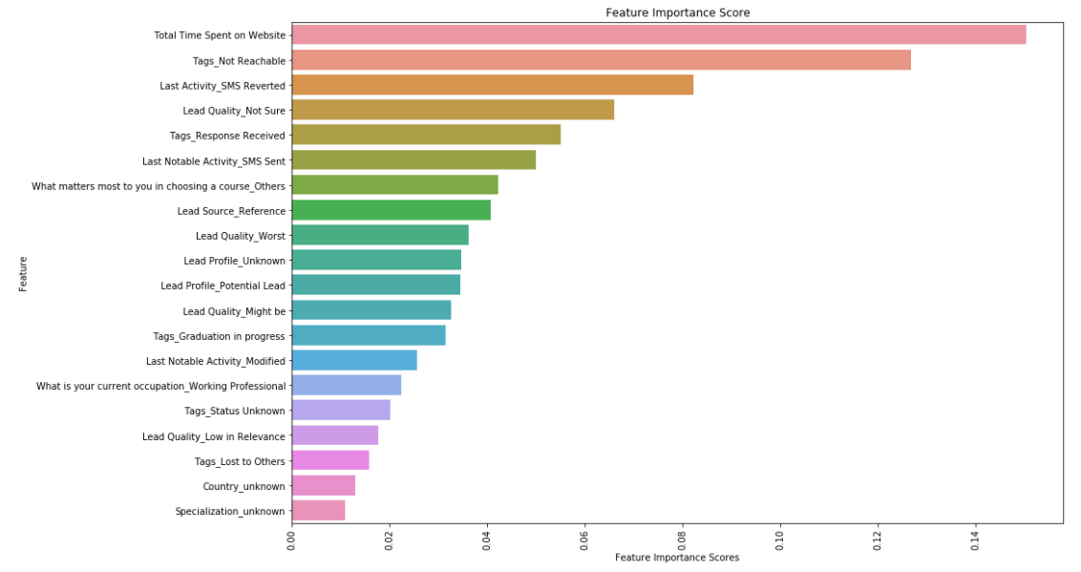
Feature importance scores on the basis of best performing model i.e. Gradient Boosting Classifier
The top 5 features important features we got are ‘Total Time Spent on Website’ followed by ‘Tags_Not Reachable’ , ‘Last Activity_SMS Reverted’, ‘Lead Quality_Not Sure’ and ‘Tags_Response Received’ .

Slide 41
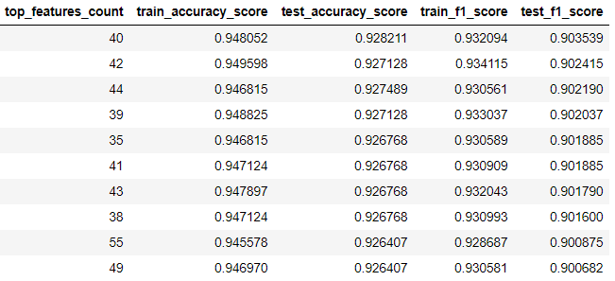
Accuracy score, F1 score with Gradient Boosting Classifier at different counts of Most Important Features
Above result shows with top 40 important features the F1 score and Accuracy score is the highest on the test set.
Gradient Boosting Classifier with top 40 features is giving better result compared to Stacking Algorithm.
Conclusion:
After building different classifiers we came up with Gradient Boosting Classifier as our best performing model built on top 40 important features

Slide 42
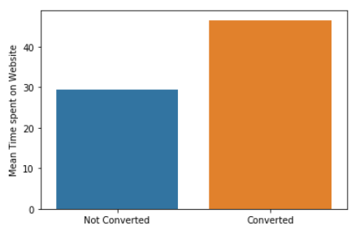
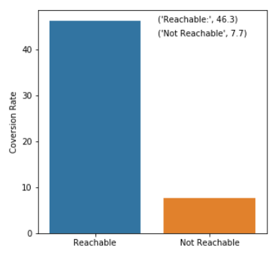
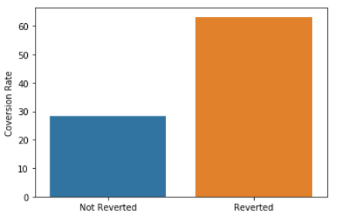
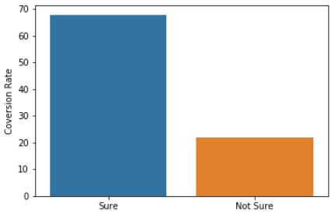
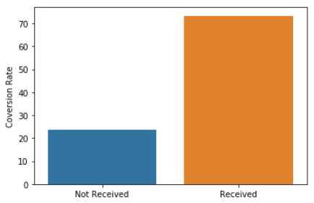
Business Insights based on top 5 Most Important Features
Reverted =63 %
Not Reverted = 28 %
Recahable =46.3%
Not Reachable =7.7%
Total Time spent on website.
Tags_Not Reachable
Last_Activity SMS Reverted
Takeaways -
Approach the leads who spend more time on website and were not converted yet.
Approach the leads who are reachable and not been converted yet. Take multiple follow ups and the progress have to be documented timely.
It has been observed that customers who have responded the SMS have got higher chances of getting converted. So approach customers who have responded the SMS and not been converted yet. Take multiple follow ups and the progress has to be documented timely.
Customers who are categorised as doubtful have got lower chances of getting converted, hence we should not further focus on these doubtful customers.
For the customers who have reverted has to be prioritized and follows ups needs to be done untill they apply for some courses with X-Edu.
Sure = 68%
Not Sure = 22%
Received = 73%
Not Received =23%
Lead Quality_Not Sure
Tags_Response Received

Slide 43
Thank You

